Slide 1
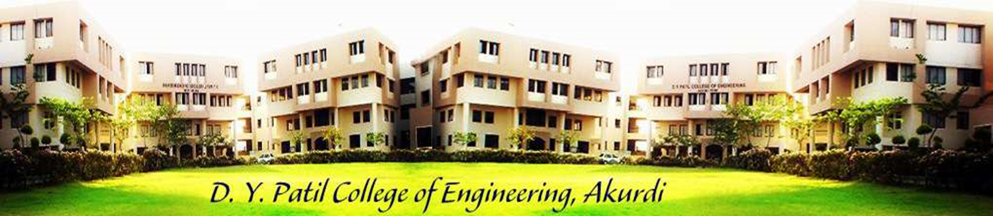
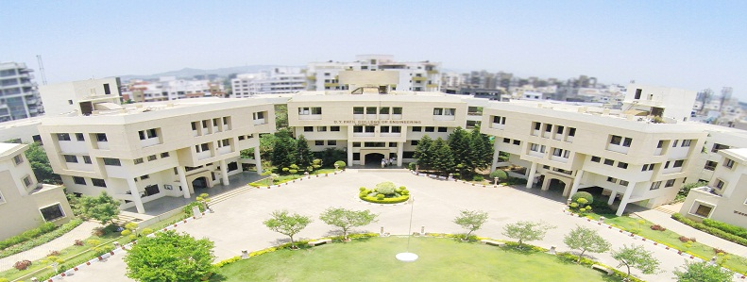
D. Y. Patil College of Engineering, Akurdi, Pune
Project Based Learning(PBL) Presentation
on
Grow Green
Tree Plantation Website
Presented By:
Name | Seat no
Kalpesh Pawar | S190088501
Rasika Ghadge | S190088549
Suraj Pisal | S190088612
Pradnya Barve | S190088613
Guided by:
Mrs. Himani Patel Mam

Slide 2

Overview
Motivation
Objective
Introduction
Literature Survey
Problem Description
Proposed System
Background
Implementation Details
Conclusion
References

Slide 3
Motivation
Mission:
Our Mission
We are on the mission to create a healthy, green and clean planet through tree plantation. Along with our diligent greening efforts, we strive to uplift and assist the rural communities, while promoting extensive agriculture across the nation and making it a happy-green paradise.
Our Vision
We work with a vision of developing lush-green and bio-diverse sustainable world for the future generations by igniting a huge environmental revolution through trees. With our each healthy sapling, we intend to create a repository for a rich ecological bio diverse planet.

Slide 4
Objective
Our moto:
“We are crazy nature- centric enthusiasts, planting trees for the people, by the people!”

Slide 5
Introduction
Why Trees?
The Generosity of Trees
Trees filter our air and keep it fresh by absorbing carbon dioxide and producing oxygen.
Tree roots stabilize the soil and prevent erosion.
Trees improve water quality by slowing and filtering rain water as well as protect aquifers and watersheds.
Trees are carbon sinks, accumulating carbon as they grow and acting as stable carbon stores upon maturity
Three-quarters of the world's people rely on wood as their main source of energy.
Thousand of things are made from trees such as furniture, books, newspapers, houses, hockey sticks, guitars, pencils, fences, milk cartons, even nail polish and toothpaste.

Slide 6
Introduction
Trees lower air temperature and induce rainfall by evaporating water from their leaves.
Trees provide food, shade and shelter to humans and wildlife.
Trees offer protection from the downward fall of rain, sleet and hail as well as reduce storm run-off and the possibility of flooding.
Trees act as sound barriers to reduce noise pollution.
Trees play a major role in helping to conserve the intensity of the Earth's magnetic field.
Trees beautify the landscape.

Slide 7
Literature Survey
There are about 20,000 tree species in the world. India has one of the largest tree treasuries in the world followed by the US.
Incredible Facts About Trees
Oldest
Slowest
Tallest
Most Massive
Deepest Roots
Fastest Growing
Greatest Girth
Most Dangerous

Slide 8
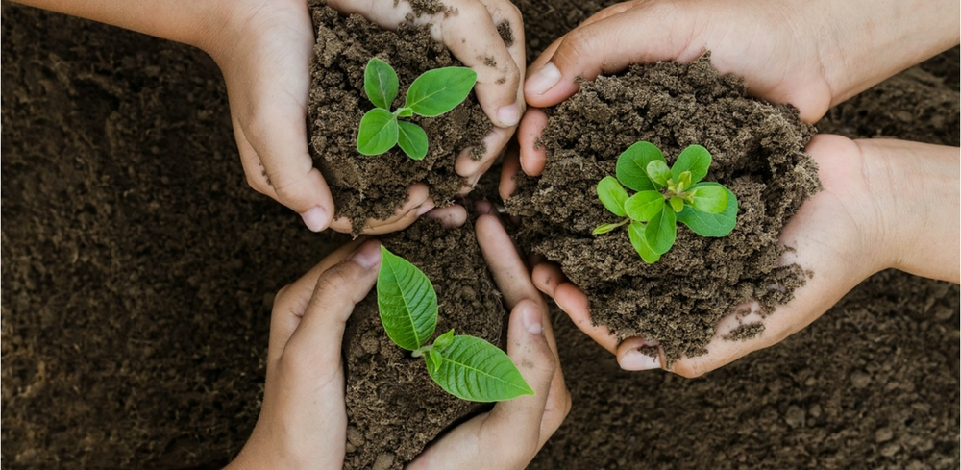
Problem Description
Problem Statement:
The purpose of tree plantation is to save the endangered environment and to beautify our life. Trees are valuable gifts of nature.
Problem Solution
We provide a platform where anyone can plant or donate a tree and provide helping hand for saving our environment

Slide 9
Proposed System
In a nutshell, here's how our online tree plantation services work:
1. You call us on our phone number listed on the website.
2. We discuss with you all the available options regarding online tree plantation.
3. You take a decision according to your budget and timeline.
4. We plant the saplings on your behalf.
Yes, it's that straightforward. As it's a service to the nature, we really like to keep it simple.
Tree plantation is a very noble job. It's like having your own child. By planting a tree you are giving life to a tree which will benefit our nation and world for the generations to come. Also, planting a tree with our online plantation services is more than just its environmental impact. It's also about the positive message you spread within your network by showcasing a good deed. It's about the hundreds of people you inspire in the society to do the same. We'll be happy to help you every way we can.

Slide 10
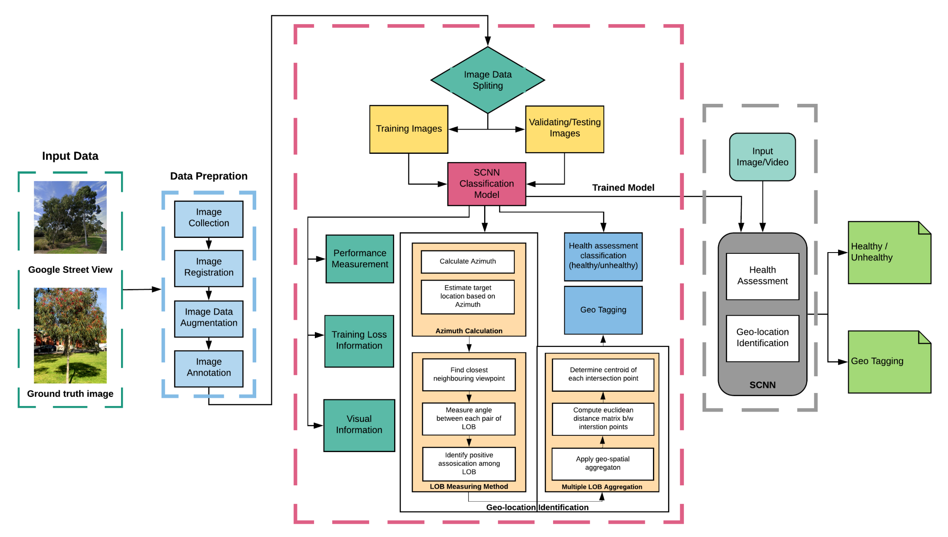
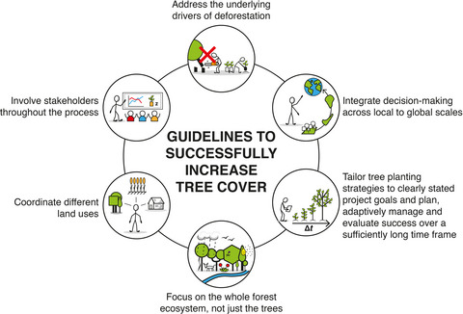
System Block Diagram

Slide 11
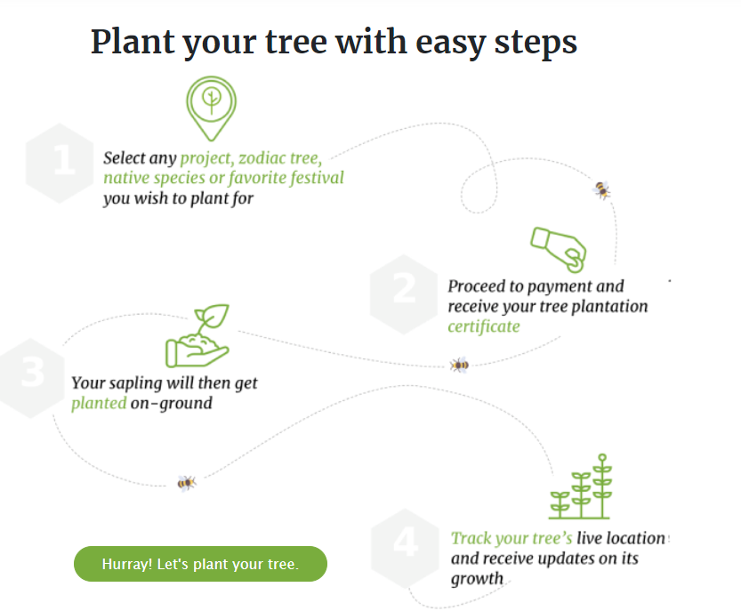
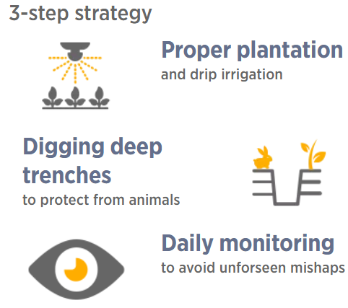
Data Flow Diagram

Slide 12
Implementation Details
Strategy
Planting trees and ensuring that the survival rate is high is one of the responsibilities that The Art of Living takes seriously. The trees we have planted have a 90% survival rate. This has been possible because of our 3- step strategy:
Planting saplings and plants and using drip irrigation
Digging deep trenches to protect from animals
Daily monitoring to avoid unforeseen mishaps
Drip irrigation systems bring down water footprint and thereby maintenance costs significantly. Creation of deep trenches helps in reducing sapling protection costs significantly as compared to building individual tree guards around each sapling to protect them from being local cattle. These trenches help in harvesting rainwater and thereby keeping soil moisture content high season, which is very critical for the high survival rate of saplings.

Slide 13
Conclusion
Trees have a lot of importance in our lives, and it provides seamless service for the environment. we have somehow not protected them and perhaps that is why as on today we are being affected by global warming, severe pollution and other ill effects of deforestation. Trees should be treated and nurtured nicely so that human beings can survive on this planet. We should encourage others to plant more and more trees. It is for our own betterment and the sooner we understand this the better it is for us.

Slide 14
References
https://www.nelda.org.in/
https://sankalptaru.org/
https://catchfoundation.in/plantenance/
https://en.wikipedia.org/wiki/Tree_planting
https://treesisters.org/blog/how-to-start-your-own-tree-planting-project
https://www.artofliving.org/in-en/projects/tree-planting
http://www.cmseducation.org/environment/treeplantation.html
https://www.grow-trees.com/projects.php
.

Slide 15

THANK YOU

